Slide 1
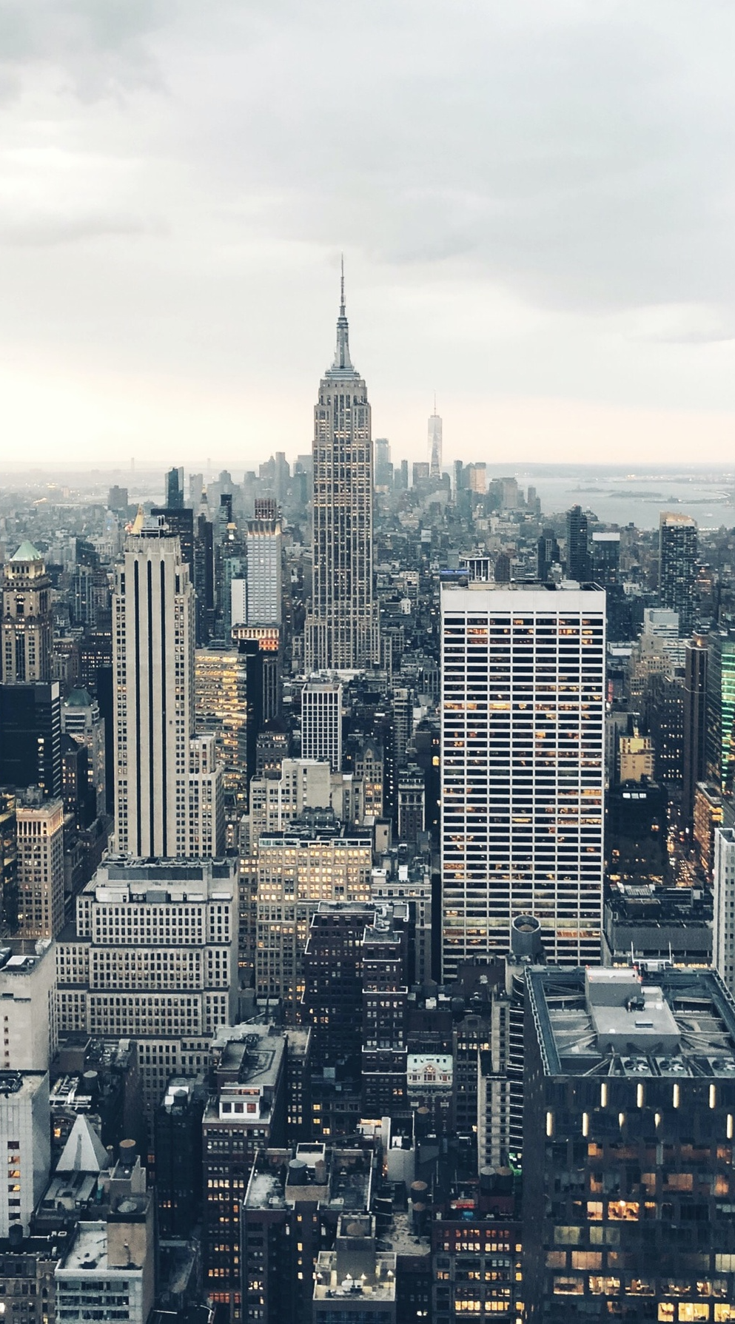

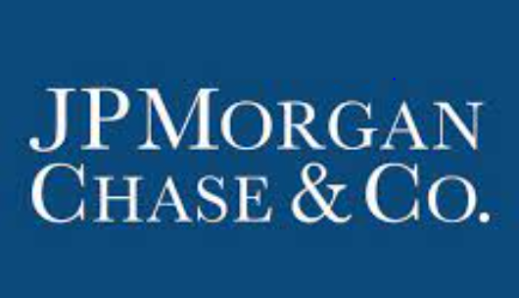

CASE STUDY
SARTHAK CHITRE

Slide 2
TABLE OF CONTENTS
OBJECTIVE
WORKFLOW
KPI’S DEFINITION
FIRM’S KEY INSIGHTS
SEGMENTATION ANALYSIS
UNTAPPED MARKETS
OTHER ASPECTS
SUMMARY

Slide 3
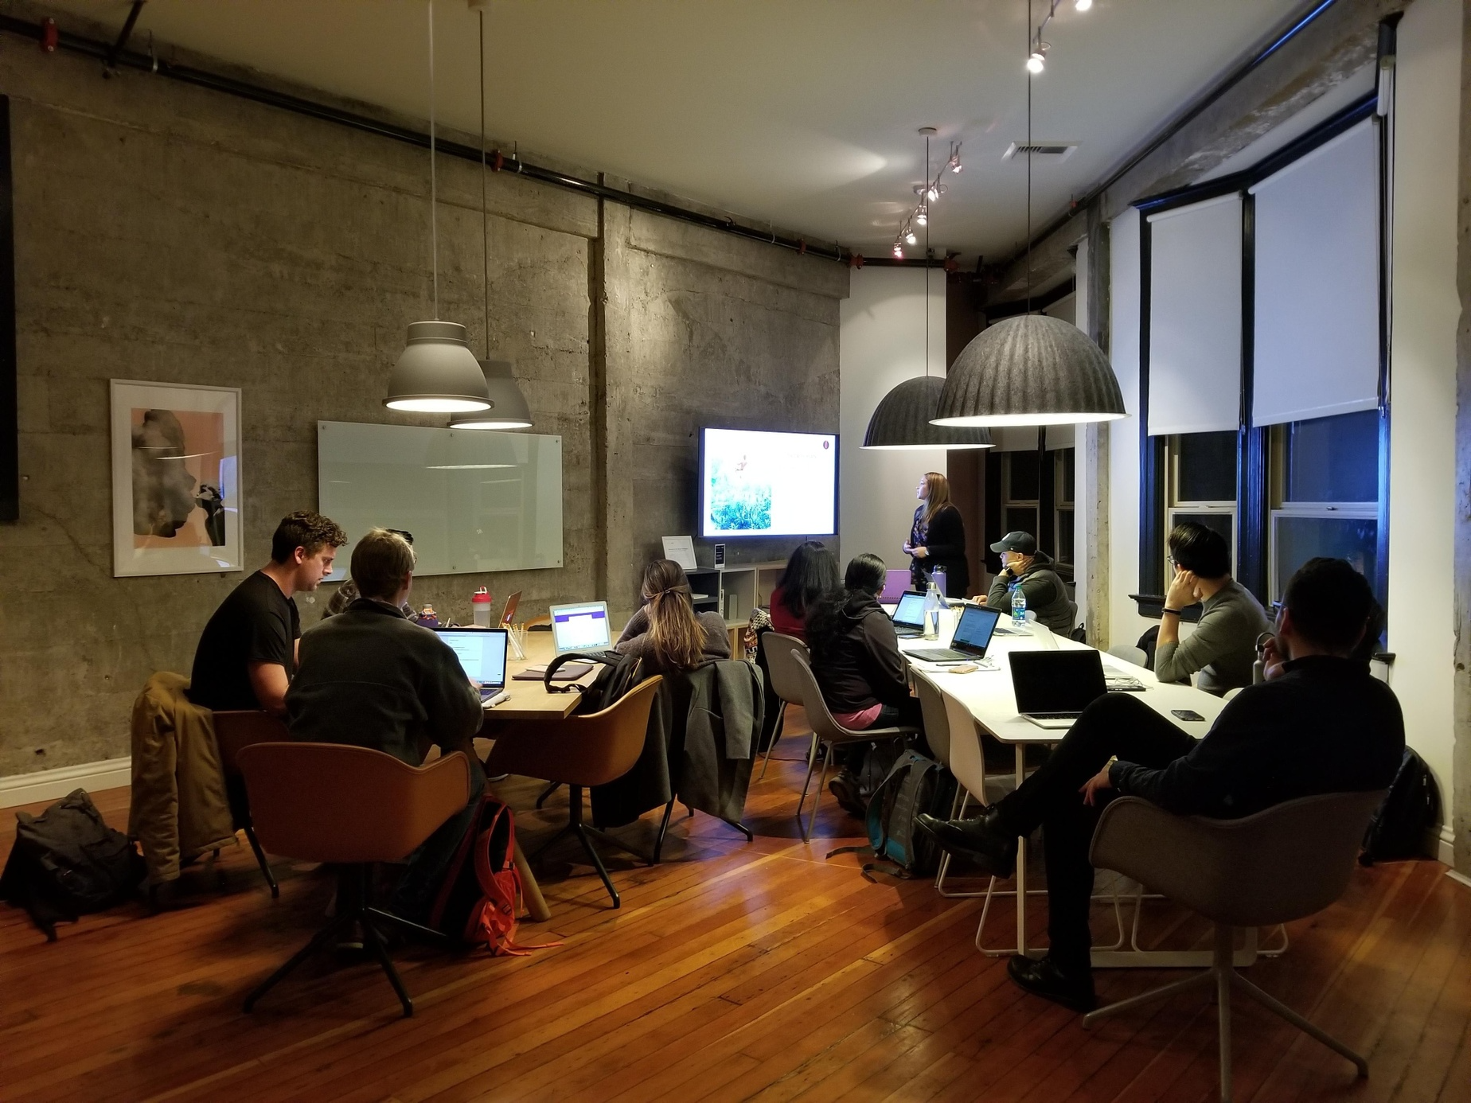
OBJECTIVE
ASSIST THE ASSET MANAGEMENT COMPANY BY EXAMINING ITS DATA AND PROVIDING INSIGHTS TO INCREASE ITS FUNDS FLOWS AND IMPROVE SALES CAPABILITIES.
IDENTIFY POTENTIAL GROWTH OPPORTUNITIES AND ANALYSE THE COMPETITIVE LANDSCAPE TO INCREASE VISIBILITY AND BOLSTER ITS MARKET SHARE.

Slide 4




WORKFLOW
1) The Firm sells its mutual fund products to intermediary brokerage firms across the United States through various sales channels.
FIRM X
2) The Firm actively communicates with these intermediaries through various means such as email, digital events, and sales team interactions to build relationships and promote its mutual fund products.
COMPETITOR’S FIRM
Intermediaries / Broker
Firms
3) The sales team not only sells the Firm's mutual funds to intermediaries but also offers mutual funds from other competing firms to the intermediaries.
Asset Management Firms
Sales Agents

Slide 5




KPI’s Definition
#1 MARKET SHARE
#3 CALL/MEET RATE
Percentage Ratio of the sum of client sales to the sum of global sales
Percentage Ratio of the count of Salesforce Meet/Call with the Intermediaries to Total Records *
#2 EMAIL CLICK RATE
#4 EVENT RATE
Percentage Ratio of the count of Emails Opened to Total Records *
Percentage Ratio of the count of Digital Events attended by the Intermediaries to Total Records *
These KPIs would define the performance on all scales and help us monitor trends in our analysis.
Call/Meet, Email Click, Event Rates are the KPIs defined based on the different engagement channels between the Firm and the other Brokers these would be collectively referred to as Engagement Rates.
* The count of total number of records would be considered as per the total records present in each segment while doing analysis.

Slide 6
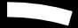


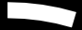




4.6%
MARKET SHARE
$156.82 B
GLOBAL SALES
40.7%
EMAIL CLICK RATE
$7.22 B
FIRM SALES
FIRM’S
KEY INSIGHTS
24.3%
CALL/MEET RATE
11.2%
EVENT RATE
9285
BROKERS
100
SALES AGENTS
103
FUND CATEGORIES

Slide 7
REGIONAL ANALYSIS
Top 5 states with the Highest Client Sales:
States | Client Sales($) | Global Sales($) | Market Share(%)
California | 0.84B | 18.42B | 4.55
New York | 0.59B | 12.62B | 4.64
Texas | 0.49B | 10.23B | 4.81
Florida | 0.36B | 7.82B | 4.60
Ohio | 0.35B | 6.28B | 5.57
Total | 2.63B | 55.37B | 4.83
States like Pennsylvania, Michigan, Illinois, New Jersey, and Arizona also had significant Client Sales.
Top 5 states with the Highest Market Share:
States | Client Sales($) | Global Sales($) | Market Share(%)
Arizona | 0.20B | 2.73B | 7.23
Oregon | 0.15B | 2.17B | 6.80
Missouri | 0.19B | 2.97B | 6.27
Ohio | 0.35B | 6.28B | 5.57
Indiana | 0.17B | 3.18B | 5.28
Total | 1.06B | 17.33B | 6.23

Slide 8
BROKER ANALYSIS
Top 5 Brokers with the Highest Client Sales:
Brokers | Client Sales($) | Global Sales($) | Market Share(%) | Email Click Rate(%) | Call/Meet Rate(%) | Event Rate(%)
AAG1 | 1.14B | 16.64B | 6.88 | 50.71 | 50.62 | 11.69
AAS7 | 0.69B | 3.26B | 21.23 | 0.44 | 55.69
AAD4 | 0.50B | 17.34B | 2.87 | 88.57 | 74.44 | 50.66
AAJ3 | 0.44B | 11.99B | 3.66 | 61.78 | 35.25 | 15.26
AAP0 | 0.42B | 9.25B | 4.58 | 44.74 | 20.22 | 13.16
Total | 3.20B | 58.48B | 7.84% | 49.25 | 47.24 | 22.70
These brokers contribute up to 45% of total client sales. The highlighted fields show the Engagement Rates are significantly lower than the overall average. Focusing and improving the rates for the above mentioned fields might help us increase client sales and market share.
Top 5 brokers with the Highest Engagement Rates:
Brokers | Client Sales($) | Global Sales($) | Market Share(%) | Email Click Rate(%) | Call/Meet Rate(%) | Event Rate(%)
AAD4 | 0.497B | 17.34B | 2.87 | 88.57 | 74.44 | 50.66
AEB9 | 0.001B | 0.26B | 0.42 | 74.07 | 74.07 | 74.07
AEU8 | 0.004B | 0.17B | 2.06 | 88.24 | 88.24 | 88.24
AEB1 | 0.004B | 0.26B | 1.54 | 65.78 | 54.49 | 54.49
AFW6 | 0.002B | 0.14B | 1.28 | 100.00 | 100.00 | 100.00
Total | 0.51B | 18.17B | 1.63 | 83.33 | 78.25 | 73.49
These brokers despite having a high Engagement Rate and significant global sales; the Firm Sales and respective Market Shares are significantly low. Need to explore additional data points to investigate the cause.

Slide 9
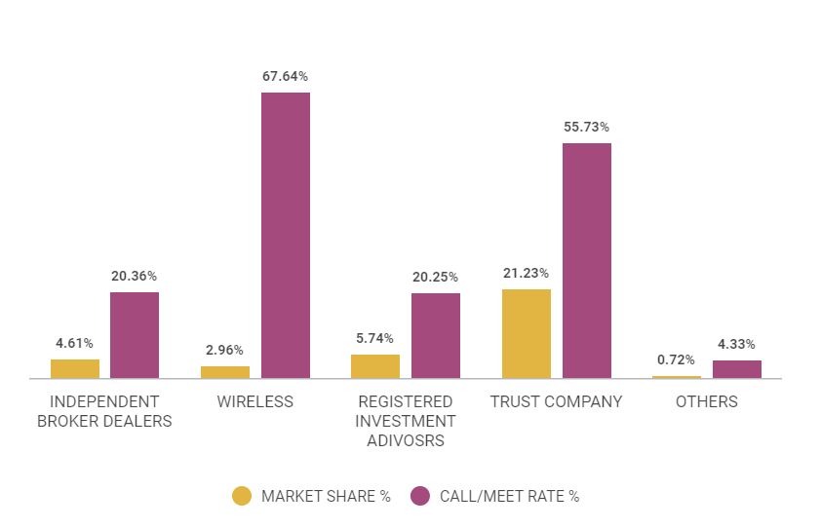
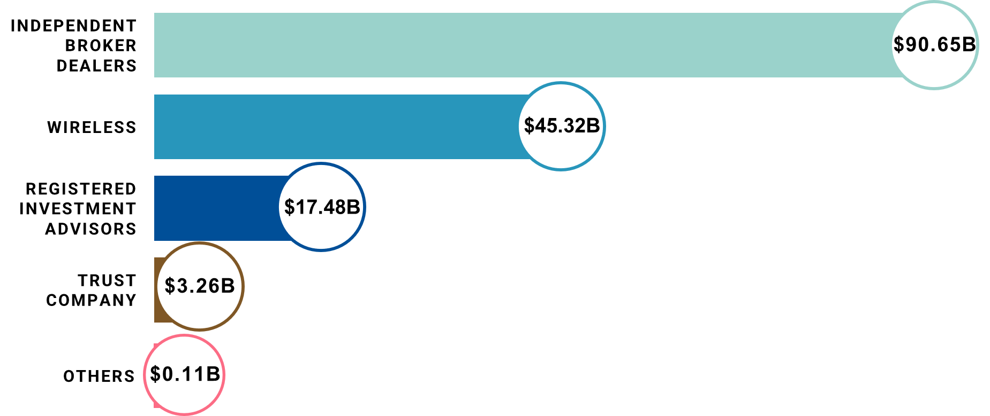
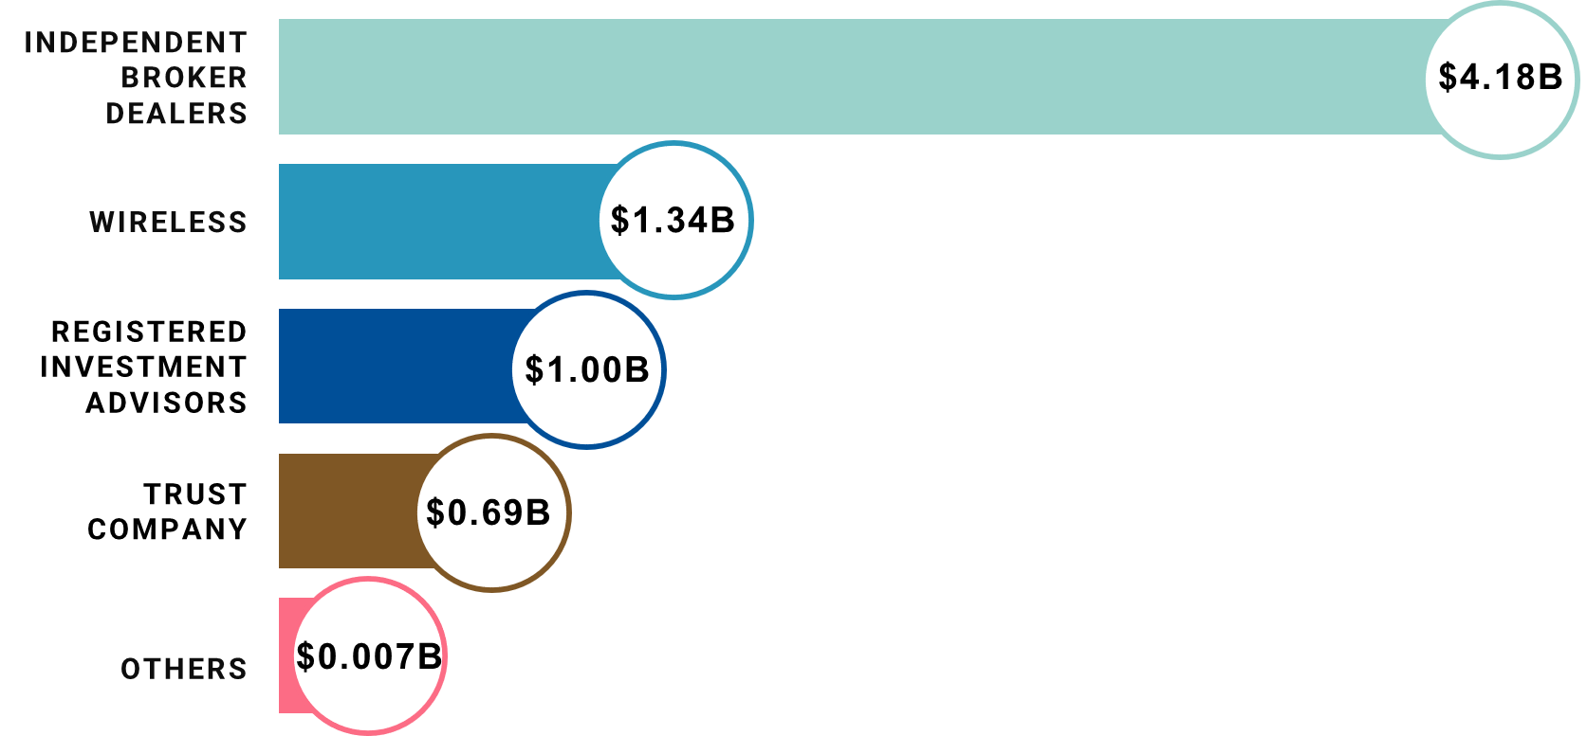





SALES CHANNEL ANALYSIS
KEY HIGHLIGHTS
SALES AGENTS ARE CLASSIFIED INTO 5 CATEGORIES
INDEPENDENT BROKER DEALERS HAVE THE HIGHEST AMOUNT OF GLOBAL, CLIENT SALES AND THE NUMBER OF AGENTS
WIRELESS & TRUST COMPANY CHANNELS HAD THE HIGHEST CALL/MEET RATE.
TRUST COMPANY CHANNEL DESPITE HAVING A LESS AGENT COUNT HAD THE HIGHEST MARKET SHARE%
`
GLOBAL SALES ACROSS CHANNELS
MARKET SHARE & CALL/MEET RATE ACROSS CHANNELS
CLIENT SALES ACROSS CHANNELS
NUMBER OF AGENTS ACROSS CHANNELS
INDEPENDENT BROKER DEALERS
26
WIRELESS
45
REGISTERED INVESTMENT ADVISORS
TRUST COMPANY
14
OTHERS
7
8

Slide 10
FUND CATEGORY ANALYSIS
Top 5 Funds with the Highest Global Sales:
Fund Category | Client Sales($) | Global Sales($) | Market Share(%)
Intermediate-Term Bond | 1.16B | 13.25B | 8.77
Multisector Bond | 0.26B | 11.01B | 2.36
Ultrashort Bond | 0.02B | 9.23B | 0.23
Large Growth | 0.50B | 8.80B | 5.64
Short-Term Bond | 0.06B | 7.52B | 0.84
Total | 2.00B | 49.83B | 3.57
Highlighted funds along with other categories such as Allocation 50-70% equity, World Large Stock, Bank Loan, Muni National Interm had a low Market Share % considering they have significant contributions in Global Sales. For the above mentioned funds, sales agents belonging to Wireless category had the lowest Market Share[0.12%] despite having the highest Call/Meet Rate [65%] compared to other sales channels.
Top 5 Funds with the Highest Client Sales:
Fund Category | Client Sales($) | Global Sales($) | Market Share(%)
Intermediate-Term Bond | 1.16B | 13.25B | 8.77
Large Value | 0.94B | 7.10B | 13.19
Allocation--30% to 50% Equity | 0.56B | 4.05B | 13.82
Large Growth | 0.50B | 8.80B | 5.64
Nontraditional Bond | 0.48B | 3.96B | 12.05
Total | 3.63B | 37.17B | 10.69
For the above mentioned funds, sales agents belonging to Trust Company category had the highest Market Share[44%] with Call/Meet Rate [55%] as compared to other sales channels.

Slide 11




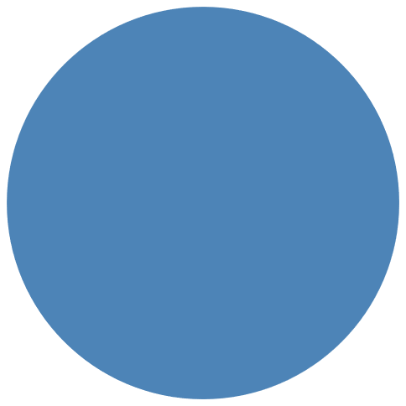





UNTAPPED MARKETS
Untapped Markets are those areas were the Firm Sales and the Market Share % is zero. The analysis is further split into Mutual Fund Categories and Brokers.
Fund Products
Brokers
Engagement Rate
28.2%
EMAIL CLICK RATE
47
$26.0B
5530
$10.0B
12.8%
CALL/MEET RATE
Mutual Fund Products with 0% Market
Share
Global Sales across these
Mutual Funds
Brokers with 0% Market Share
Global Sales across these
Brokers
7.2%
DIGITAL RATE
The untapped markets of Mutual Fund products form 16% of the total global sales.
Funds like Foreign Large Growth, High Yield Muni and World Bond are some significant products of the untapped markets.
If we capitalize 4% of Untapped Market Share as per our overall average. We might end up acquiring ~$1.0B market in Firm Sales which will make the Total Firm Sales ~$8.24B, leading to overall Market Share of 5.25%
We need further more data points to investigate on our growth market strategy as the Overall Engagement Rate of these Brokers is above Average.
The untapped markets of Brokers form 6.4% of the total global sales
Upto 200 Brokers form 50% of the Global Untapped market out of $10.0B.
The overall engagement rate of these brokers is below than the overall average of the Firm.
If we improve the engagement rate of these brokers we might acquire 4% of Untapped Market (~$0.4B in sales) leading to Total Firm Sales of ~$7.62B and an overall Market Share of ~4.9%

Slide 12

OTHER ASPECTS
After contemplating all the segments of analysis we found that there is no strong correlation between the Engagement rates and the Firm Sales.
Certain set of Brokers were the Firm maintained High Engagement Rates didn’t assure a higher Market Share.
Wireless Sales Channel had the lowest Market Share despite having a higher Call/Meet Rate %.
Maybe we need to investigate more data points to understand the underlying cause.
Requirements of additional Data points like date of sales transaction, formation years of these Brokers, years since these Brokers and the sales agent are associated with our Firm; will immensely help us to carry retrospective analysis. This will help us segregate the Top performing Agents, Brokers or Fund Categories and target the areas where the business is declining.
We also found brokers that had higher Email Click Rates or Event Rate which eventually means they were ready or interested to buy the Firm’s Mutual Fund product but didn’t buy. Here, we need to understand whether the product features that the Firm offers are different from the competitor’s or if there any Sales Incentivization issues, TAT (Turn around Time) issues in operational transactions or any other anonymous gaps.

Slide 13

SUMMARY
REGIONAL ANALYSIS
BROKER ANALYSIS
SALES CHANNEL ANALYSIS
California, New-York, Texas have the highest share of global sales. Maintaining a steady/higher Market Share% in these states is essential.
Improving the Engagement Rates of the Top 5 Brokers with the highest global sales might help the Firm elevate its Market Share %.
IBD channel plays a pivotal role in managing sales across the Firm and globe.
Trust Company Channel had the highest Market Share% and Wireless the least.
FUND CATEGORY ANALYSIS
UNTAPPED MARKETS
OTHER ASPECTS
Ultrashort & Short-Term Bonds had a low Market Share % but significantly contribute toward Global Sales. The firm imperatively needs to focus on these bonds to increase its Sales
Targeting the untapped markets of Brokers and Fund Categories will help the Firm drive its growth and bolster Market penetration.
The analysis ascertains that Engagement Rates aren't the only KPIs that can define Firm Sales. Need to explore more data points to understand the dynamics of the same.

Slide 14
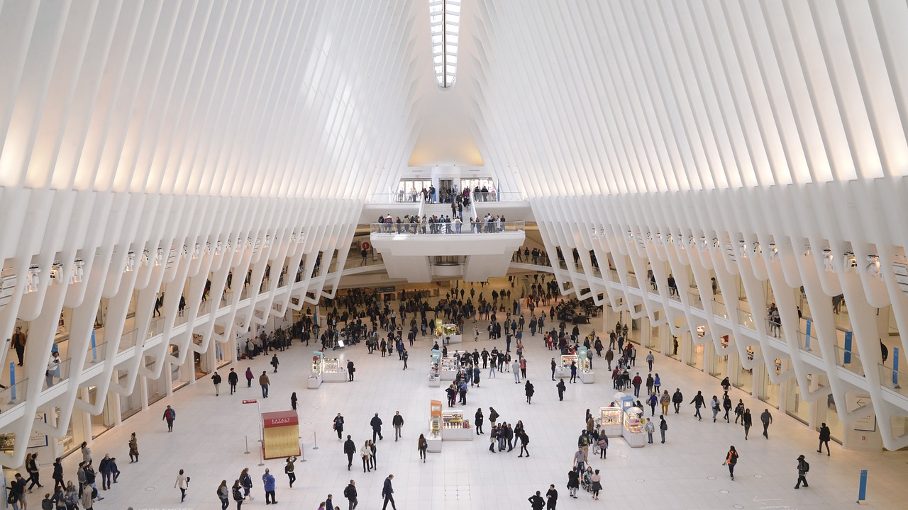
THE END

